Slide 1
Test-first development (XP’s innovation)
Plan driven approach
Specifications
Implementation
Testing
Any issue
XP’s approach (test first development)
Client requirements
Test cases
Implementation
Any issue encountered during implementation

Slide 2
Test-first development
XP testing advantages:
Problems of requirements misunderstanding are reduced as you have developed test cases as per your program’s behaviors.
Avoids test-lag (when developer is faster than tester so pace mismatch)
User involvement in test development and validation.
Tests are written as programs rather than data so that they can be executed automatically whenever a new functionality is added to a module.

Slide 3
Customer involvement
ROLE:
to help develop acceptance tests for the stories that are to be implemented in the next release of the system.
If customer is a full time member of development team, then he/she may write testcases as well.
ISSUE:
Customer have limited time. So he might be reluctant to offer his services full time with development team.

Slide 4
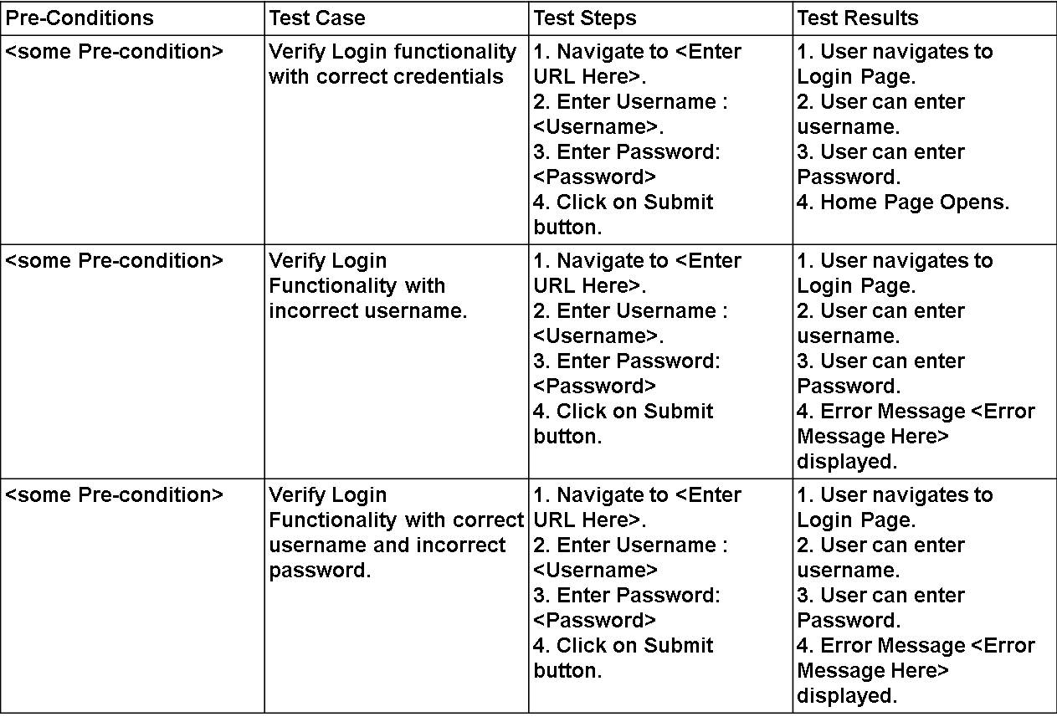
Test cases examples

Slide 5
Test automation
Tests are conducted using automated test tools, they simulate the program depending upon the input and check if the results meets the specifications.
A specific set of tests is quickly and easily executed whenever any functionality is added to the system, these automated test cases can be run, and problems in the new code can be identified immediately.

Slide 6
Problems with test-first development
Programmers prefer programming to testing and sometimes they take short cuts when writing tests. For example, they may write incomplete tests that do not check for all possible exceptions that may occur.
Some tests can be very difficult to write incrementally. For example, in a complex user interface, it is often difficult to write unit tests for the code that implements the ‘display logic’ and workflow between screens. As design is changing continuously.
It difficult to judge the completeness of a set of tests. Although you may have a lot of system tests, your test set may not provide complete coverage.

Slide 7
Pair programming (XP’s innovation)
Pair programming involves programmers working in pairs, developing code together.
This helps develop common ownership of code and spreads knowledge across the team.
It serves as an informal review process as each line of code is looked at by more than 1 person. Code implementation and inspection @ same time.
A person doing refactoring is considered less efficient than the one doing coding. So, this process encourages refactoring as due to common ownership, the whole team can get benefit from the improved system code.

Slide 8
Pair programming
In pair programming, programmers sit together at the same computer to develop the software.
Pairs are created dynamically so that all team members work with each other during the development process.
The sharing of knowledge that happens during pair programming is very important as it reduces the overall risks to a project when team members leave.
Pair programming is not necessarily inefficient and there is some evidence that suggests that a pair working together is more efficient than 2 programmers working separately.

Slide 9
Pair programming
Pair programming is not practiced mostly because mostly organizations think that two people working separately can do better than two doing in group.
Solution?
Still, some of them believe it and practice it with slight modification in a way that in a pair of two, one is a senior developer and the other one is a junior developer to support the collaborative learning.
This shared learning reduces overall risks to project (in case a senior employee left).

Slide 10
Agile project management

Slide 11
Agile project management
Software project managers focus on:
In-time software delivery
and within the planned budget.
Agile project management used an approach which is adapted to incremental development and the practices used in agile methods.

Slide 12
Scrum
Scrum is an agile method that provides a project management framework
There are three phases in Scrum.
The initial phase is an outline planning phase where you establish the general objectives for the project and design the software architecture.
This is followed by a series of sprint cycles, where each cycle develops an increment of the system.
The project closure phase wraps up the project, completes required documentation such as system help frames and user manuals and assesses the lessons learned from the project.

Slide 13
Scrum terminology
Scrum term | Definition
Development team | self-organizing group of software developers no more than 7 people. responsible for developing the software and essential project documents.
Sprint | A development iteration. usually 2-4 weeks long.
Potentially shippable product increment | The software increment that is delivered from a sprint. ‘potentially shippable’ means it is in a finished state and no testing or any other work left to add it into the final product.
Product backlog | To-do list for Scrum Team. It might be user stories or descriptions of supplementary tasks that are needed, such as architecture definition or user documentation.
Product owner | Identify requirements prioritize these for development continuously review the product backlog to ensure that the project continues to meet critical business needs. He/she could be a customer/product manager/a stakeholder representative.

Slide 14
Scrum terminology
Scrum term | Definition
Scrum | A daily meeting of the Scrum team that reviews progress and prioritizes work to be done that day. Ideally, this should be a short face-to-face meeting that includes the whole team.
Scrum Master | Take follow up of work Guides team Deals with the organization and report team work. Similar to project manager.
Velocity | An estimate of how much product backlog effort that a team can cover in a single sprint. Understanding a team’s velocity helps them estimate what can be covered in a sprint and provides a basis for performance improvement.

Slide 15
Scrum sprint cycle

Slide 16
The Scrum sprint cycle
Sprints are fixed length, normally 2–4 weeks.
The starting point for planning is the product backlog, which is the list of work to be done on the project.
The selection phase involves whole project team to select the features and functionality from the product backlog to be developed during the sprint.

Slide 17
The Sprint cycle
Once these are agreed, the team organize themselves to develop the software.
During this stage, the team is isolated from the customer and the organization, with all communications channelled through the so-called ‘Scrum master’.
The role of the Scrum master is to protect the development team from external distractions.
At the end of the sprint, the work done is reviewed and presented to stakeholders. The next sprint cycle then begins.

Slide 18
Teamwork in Scrum
‘Scrum master’:
arranges daily meetings,
tracks the backlog of work to be done,
records decisions,
measures progress against the backlog
Communicates with customers and management outside of the team.
The team:
attends short daily meetings (Scrums)
all team members share their progress, problems that have arisen and what is planned for the following day.
This means that everyone on the team knows what is going on and, if problems arise, can re-plan short-term work to cope with them.

Slide 19
Scrum benefits
The product is broken down into a set of manageable and understandable chunks.
The whole team have visibility of everything and consequently team communication is improved.
Customers see on-time delivery of increments and gain feedback on how the product works.
Trust between customers and developers is established and a positive culture is created in which everyone expects the project to succeed.

Slide 20
Distributed Scrum

Slide 21
Scaling agile methods

Slide 22
Scaling agile methods
Agile methods are successful for small and medium sized projects that can be developed by a small co-located team.
Success of these methods come because of improved communications.
Scaling Agile methods:
the process of translating established Agile methods, like Scrum to larger groups of people.
When scaling agile methods it is important to maintain agile fundamentals:
Flexible planning,
frequent system releases,
continuous integration,
test-driven development
and good team communications.

Slide 23
Scaling out and scaling up
‘Scaling up’
using agile methods for developing large software systems that cannot be developed by a small team.
‘Scaling out’
how agile methods can be introduced across a large organization with many years of software development experience.

Slide 24
Practical problems with agile methods
can be problematic for contract specifications in large organization.
mostly appropriate for new software development rather than software maintenance. Yet the majority of software costs in large companies come from maintaining their existing software systems.
designed for small co-located teams yet much software development now involves worldwide distributed teams.

Slide 25
Contractual issues
Most software contracts for custom systems are based around a specification, which sets out what has to be implemented by the system developer for the system customer.
However, this precludes interleaving specification and development as is the norm in agile development.
Solution: A contract that pays for developer time rather than functionality is required
However, this is seen as a high risk my many legal departments because what has to be delivered cannot be guaranteed.

Slide 26
Agile methods and software maintenance
Most organizations spend more on maintaining existing software than they do on new software development.
So, for agile methods to be successful, they have to support maintenance as well as original development.
Problems may arise if original development team cannot be maintained.(what if someone from the team left the organization?)

Slide 27
Agile maintenance
Key problems are:
Lack of product documentation
Keeping customers involved in the development process
Maintaining the continuity of the development team
Agile development relies on the development team knowing and understanding what has to be done.
For long-lifetime systems, this is a real problem as the original developers will not always work on the same system.

Slide 28
Agile and plan-driven methods
Most projects include elements of plan-driven and agile processes. Deciding on the balance depends on:
Is it important to have a very detailed specification and design before moving to implementation? If so, you probably need to use a plan-driven approach.
Is an incremental delivery strategy, where you deliver the software to customers and get rapid feedback from them, realistic? If so, consider using agile methods.
How large is the system that is being developed? Agile methods are most effective when the system can be developed with a small co-located team who can communicate informally. This may not be possible for large systems that require larger development teams so a plan-driven approach may have to be used.

Slide 29
Agile important factors

Slide 30
System issues
How large is the system being developed?
Agile methods are most effective a relatively small co-located team who can communicate informally.
What type of system is being developed?
Systems that require a lot of analysis before implementation need a fairly detailed design to carry out this analysis.
What is the expected system lifetime?
Long-lifetime systems require documentation to communicate the intentions of the system developers to the support team.
Is the system subject to external regulation?
If a system is regulated you will probably be required to produce detailed documentation as part of the system safety case.

Slide 31
People and teams
How good are the designers and programmers in the development team?
It is sometimes argued that agile methods require higher skill levels than plan-based approaches in which programmers simply translate a detailed design into code.
How is the development team organized?
Design documents may be required if the team is distributed.
What support technologies are available?
IDE support for visualisation and program analysis is essential if design documentation is not available.

Slide 32
Organizational issues
Traditional engineering organizations have a culture of plan-based development, as this is the norm in engineering.
Is it standard organizational practice to develop a detailed system specification?
Will customer representatives be available to provide feedback of system increments?
Can informal agile development fit into the organizational culture of detailed documentation?

Slide 33
Agile methods for large systems
Large systems-> larger teams in different zones may be
Large systems are ‘brownfield systems’,(the systems derived from an existing system). Many of the system requirements are concerned with this interaction and so don’t really lend themselves to flexibility and incremental development.
When existing systems are integrated -> a lot of time is wasted on integration rather than coding.

Slide 34
Large system development
Large systems and their development processes are often constrained by external rules and regulations limiting the way that they can be developed.
Large systems have a long procurement and development time. Its really difficult to hold people for a project.
Large systems have diverse stakeholders-> so its impossible to involve all of them in the development process.

Slide 35
Factors in large systems

Slide 36
Scaling up to large systems
A completely incremental approach to requirements engineering is impossible.
There cannot be a single product owner or customer representative.
For large systems development, it is not possible to focus only on the code of the system.
Cross-team communication mechanisms have to be designed and used.
Continuous integration is practically impossible. However, it is essential to maintain frequent system builds and regular releases of the system.

Slide 37
Multi-team Scrum
Role replication
Each team has a Product Owner for their work component and ScrumMaster.
Product architects
Each team chooses a product architect and these architects collaborate to design and evolve the overall system architecture.
Release alignment
The dates of product releases from each team are aligned so that a demonstrable and complete system is produced.
Scrum of Scrums
There is a daily Scrum of Scrums where representatives from each team meet to discuss progress and plan work to be done.

Slide 38
Agile methods across organizations
Project managers who do not have experience of agile methods may be reluctant to accept the risk of a new approach.
Large organizations often have quality procedures and standards that all projects are expected to follow and, because of their bureaucratic nature, these are likely to be incompatible with agile methods.
Agile methods seem to work best when team members have a relatively high skill level. However, within large organizations, there are likely to be a wide range of skills and abilities.
There may be cultural resistance to agile methods, especially in those organizations that have a long history of using conventional systems engineering processes.

